Slide 1


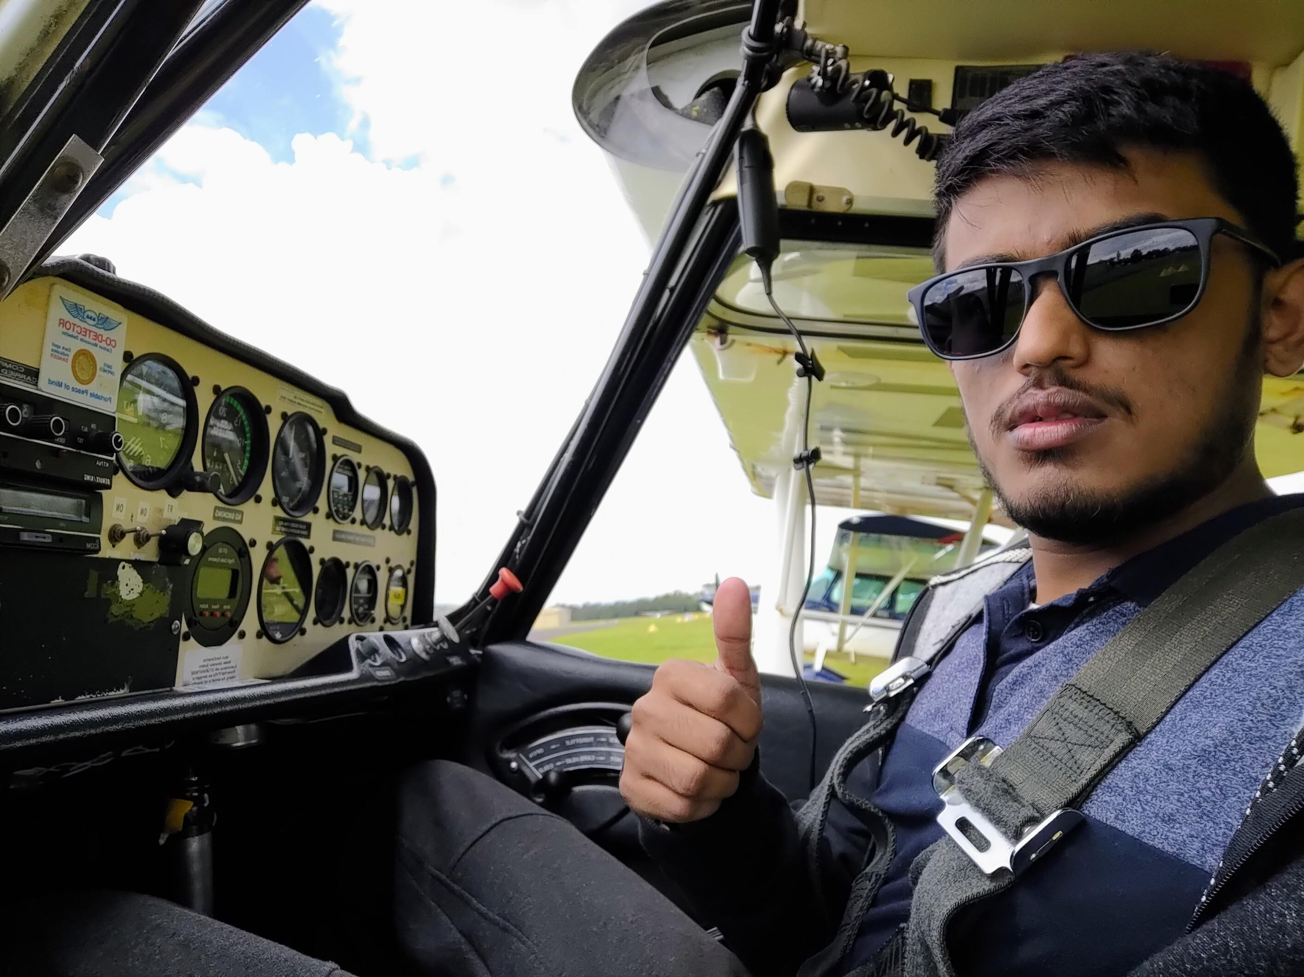
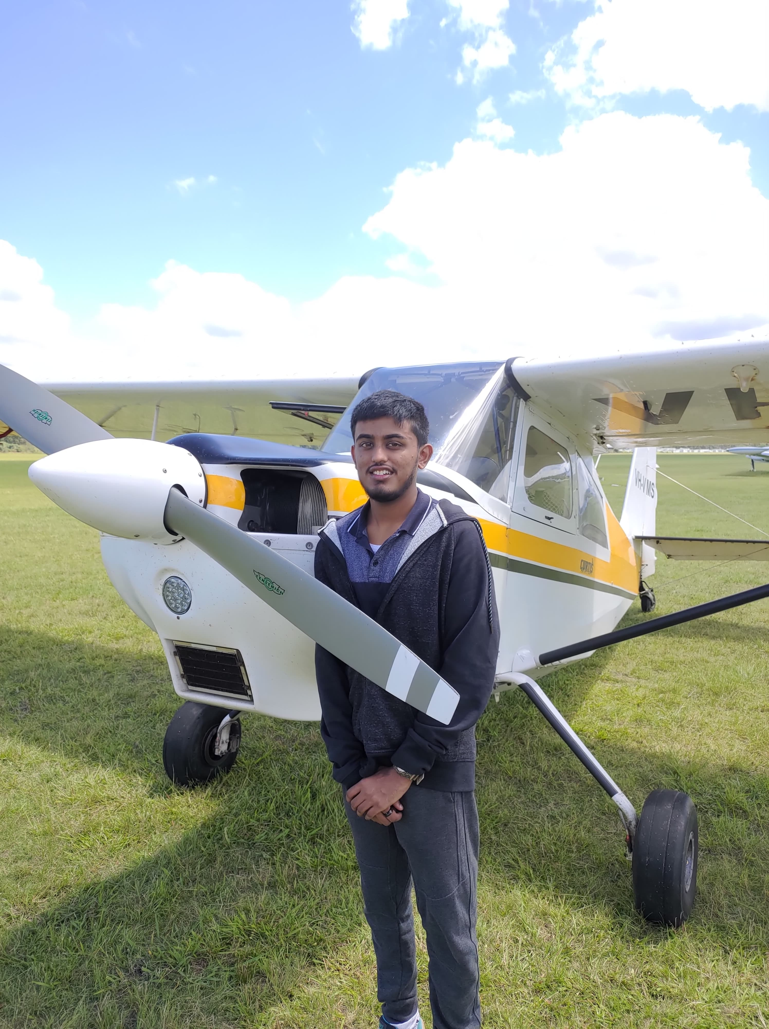
Durairaj (RAJ) Shyam
Final Semester of 4th Year
Bachelor of Aeronautical Engineering (Honours)
Some photos of me flying real and RC aircraft!

Slide 2


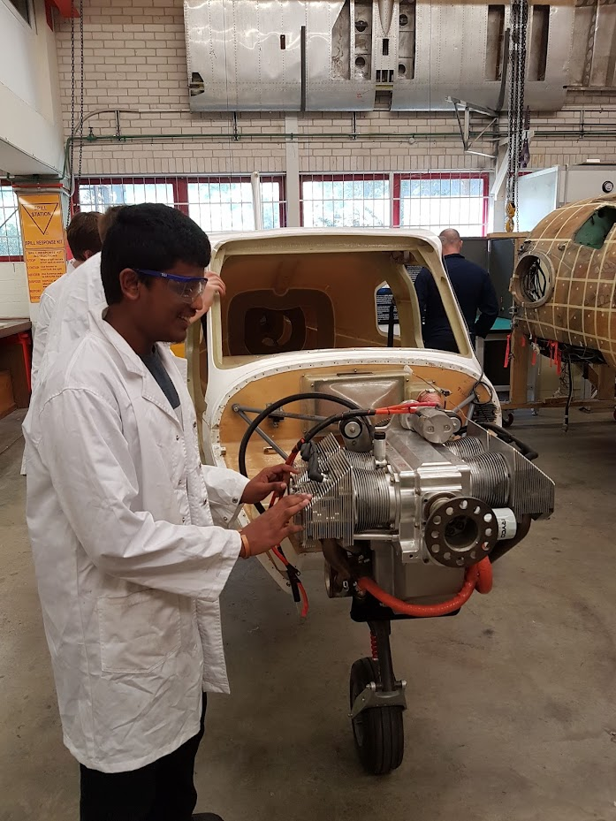
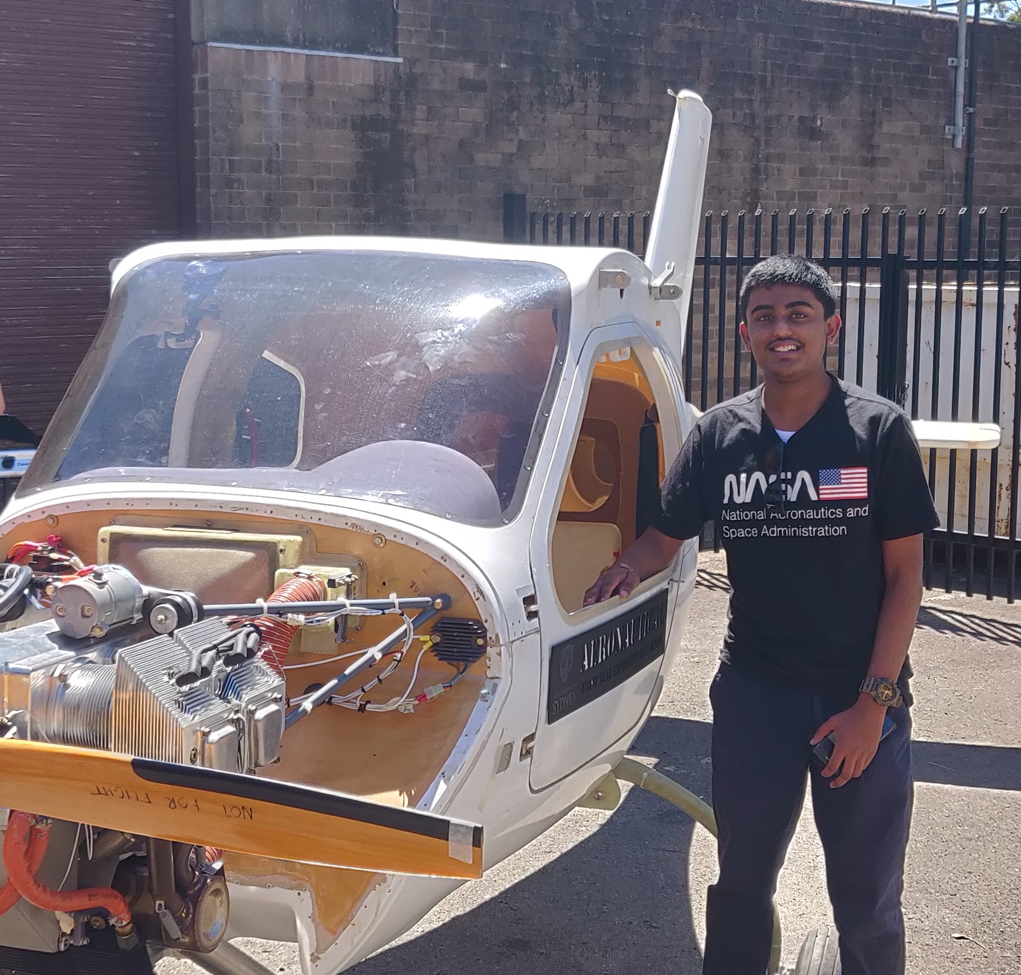
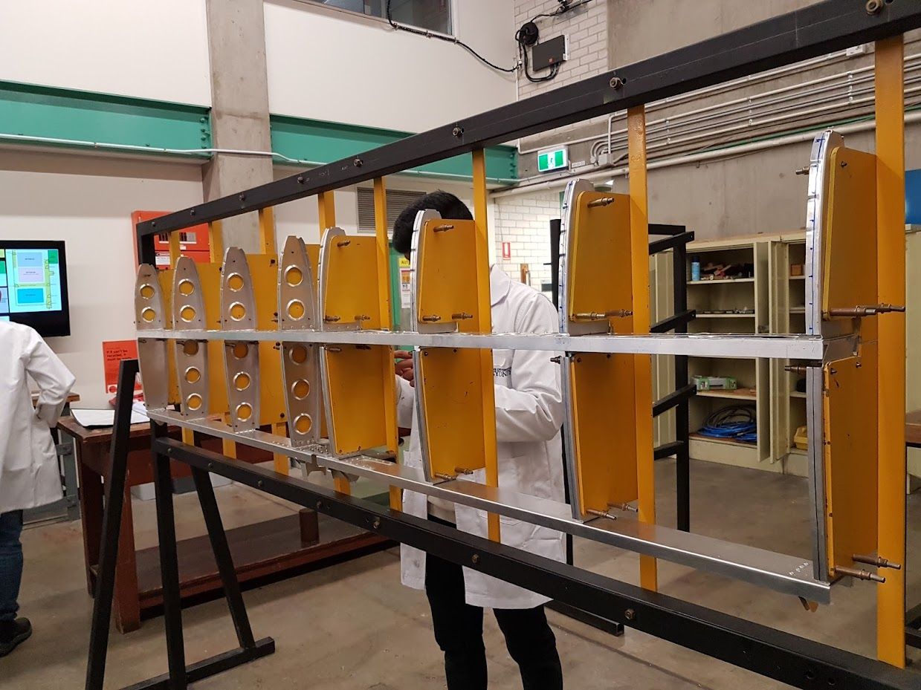
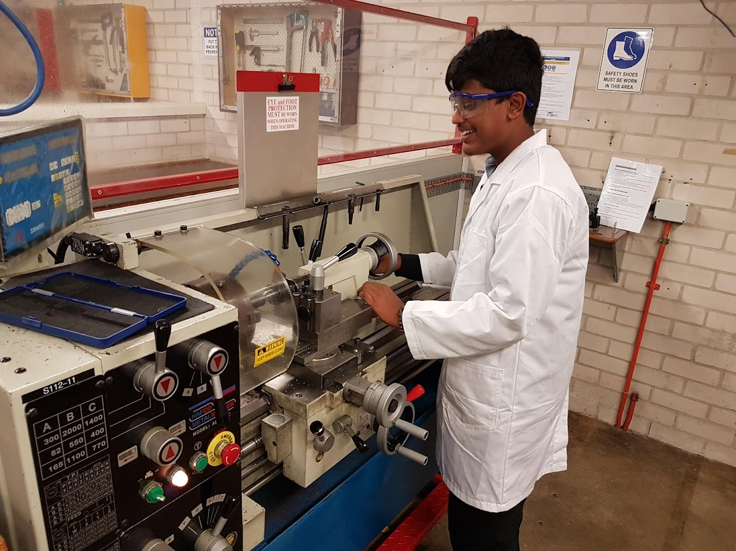
Hands-on Aircraft Builds!
Building the Jabiru J160c
Milling, Lathing, Laser-cutting, Soldering, Fibre-glassing, etc.
Aircraft T-tail construction from T3-2024 Aluminum Alloy

Slide 3
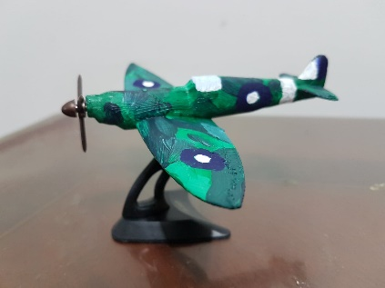
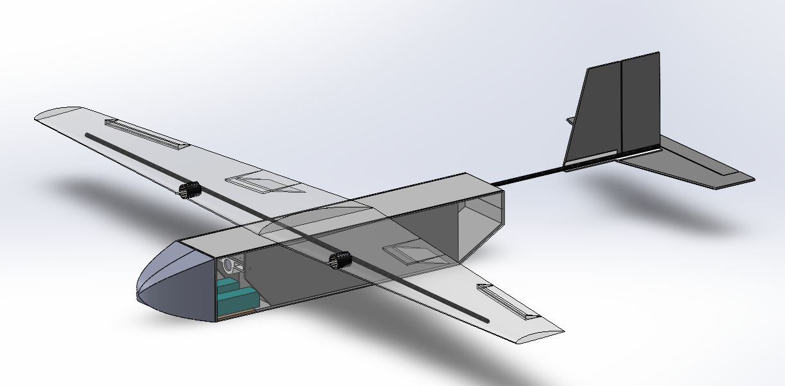
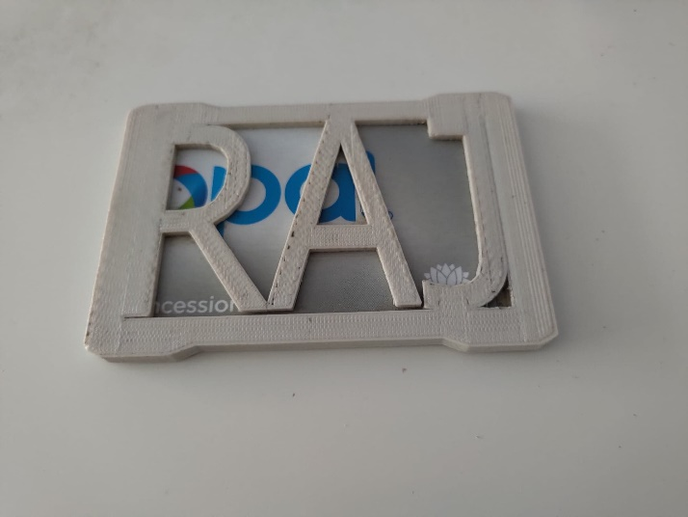
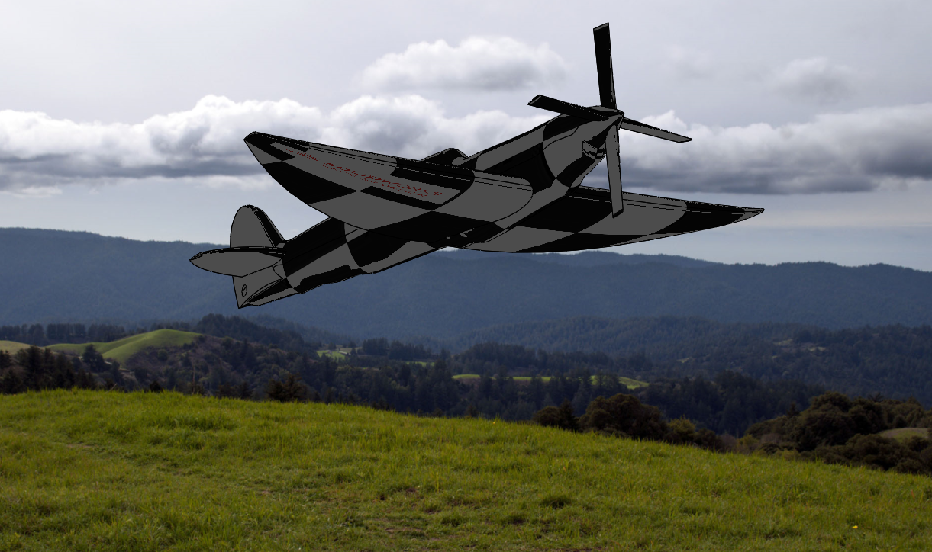
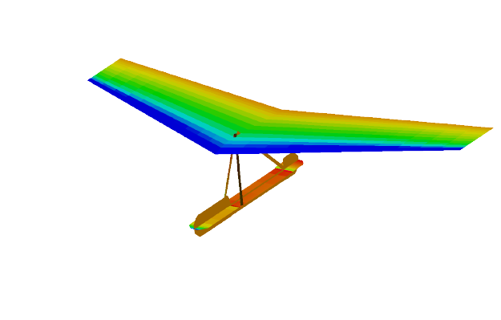
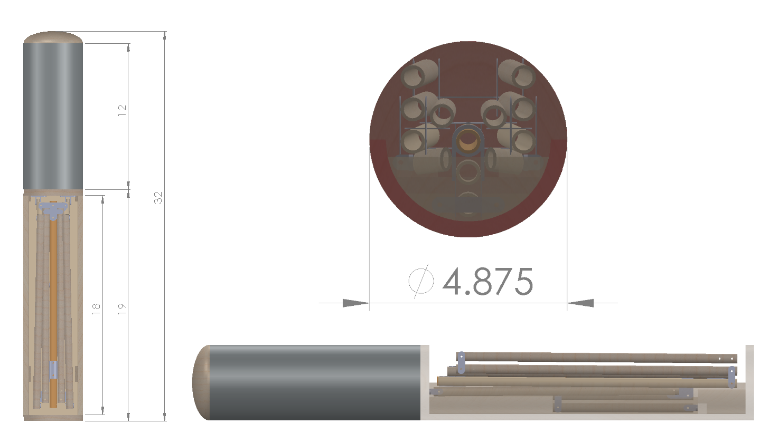
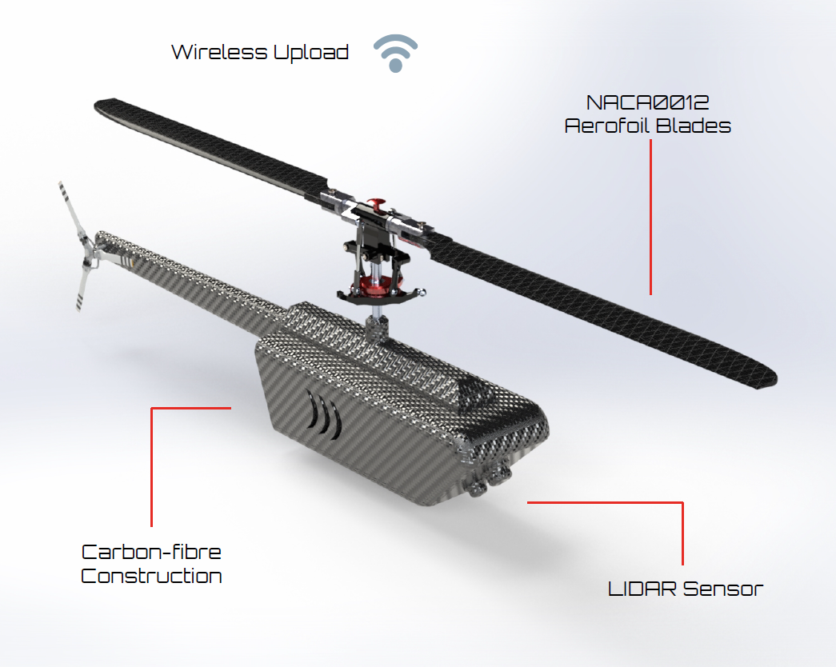
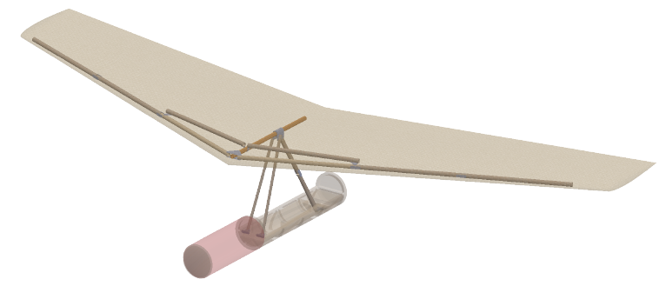
CAD & 3D Printing Projects
3D printed model (left) of scale Supermarine Spitfire Model
Detailed design CAD of STOL UAV for AIAA DBF 2021/22 Challenge - Vaccine vial/syringe transport
Custom 3D Printed Opal Card Holder with my name “RAJ”
Winged sonobuoy, unfolding UAV concept proposed for the ADF – CAD Drawings of folded (right), unfolded (left) and pressure coefficient contours (left)
Micro-drone design concept for Bushfire-prevention mapping project

